Slide 1
NACLO Prep: Round 3
Notes:
This is the third lecture in a series meant to be a mini prep course for the North American Computational Linguistics Olympiad.

Slide 2
Strange Language (Gibberish) Problems
Task: figure out what the strange words mean
Typical structure: given paragraph, sentence, or dialogue with context clues
General strategy: use your vocabulary, try to think of synonyms, think about parts of speech/word order
Notes:
Read slide

Slide 3
Phonological Problems
Similar to writing system problems
Task: figure out how things are pronounced in another language and/or use pronunciation clues to figure out word meanings
Typical structure: given some example transcriptions or cognates
General strategy: try to match them syllable by syllable, make an index of letters, similar to writing systems, just try to sound things out and notice patterns
Notes:
Read slide

Slide 4
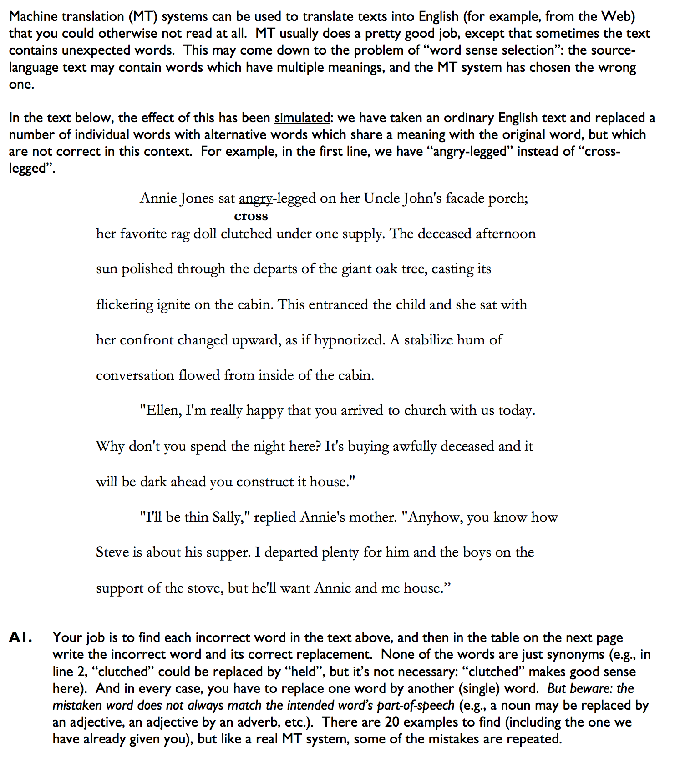
Example
Notes:
Basically the strategy here is to think of synonyms and use context clues
Give them some time (maybe 5-7 mins?) to work it out
And then show the solution

Slide 5
Solution
front
arm
late
shone
leaves
light
face
turned
steady
came
getting
late
before
make
home
fine
left
back
home
Notes:
Basically the strategy here is to think of synonyms and use context clues
Give them some time (maybe 5-7 mins?) to work it out
And then show the solution

Slide 6
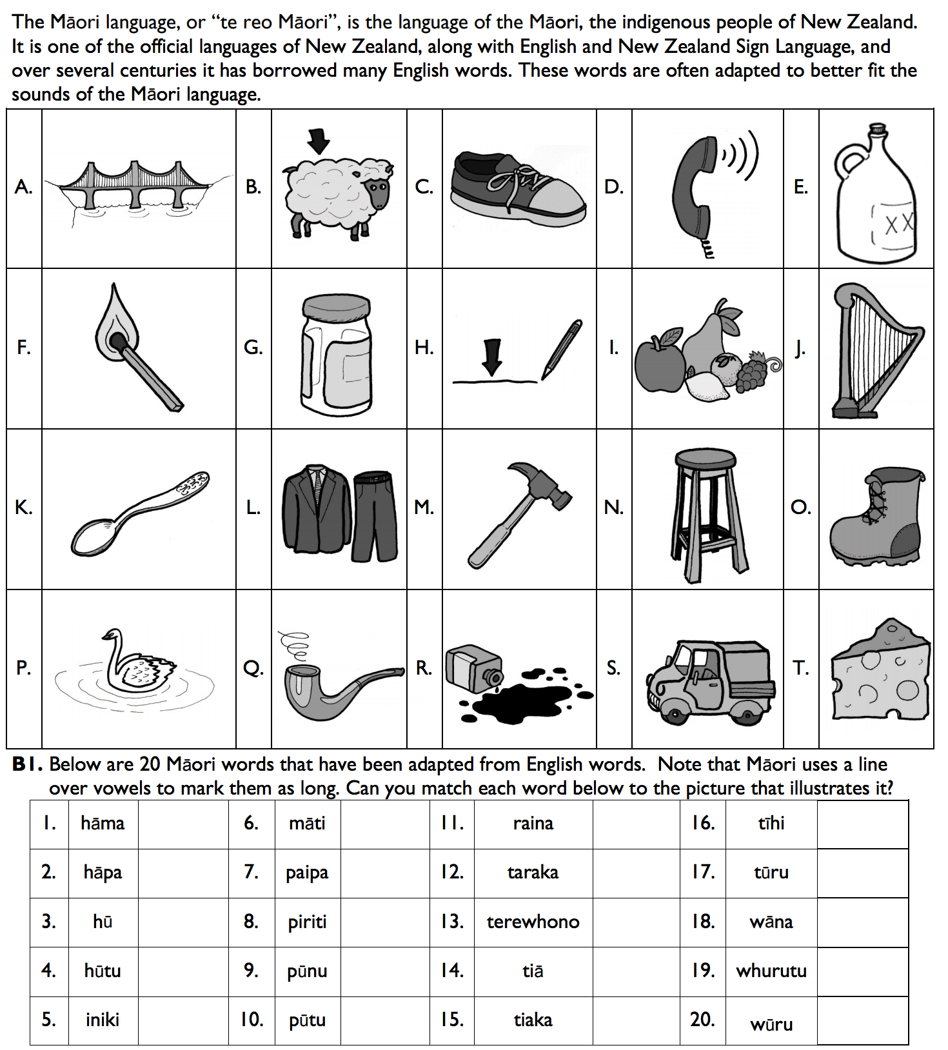
Example 1
M
F
H
T
J
Q
S
N
C
A
D
P
L
K
G
I
R
O
E
B
Notes:
The strategy is basically to sound things out
Tell them this, and then tell them to figure out what each of the English words in the picture is, and give them 5-7 mins to figure it out, and then click

